Slide 1

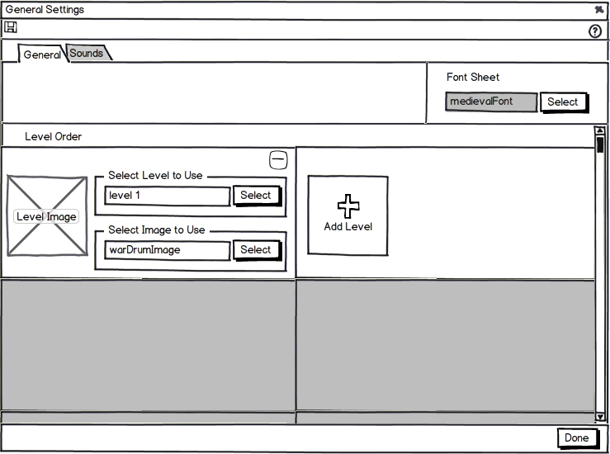
General Settings - 1
740x550

Slide 2
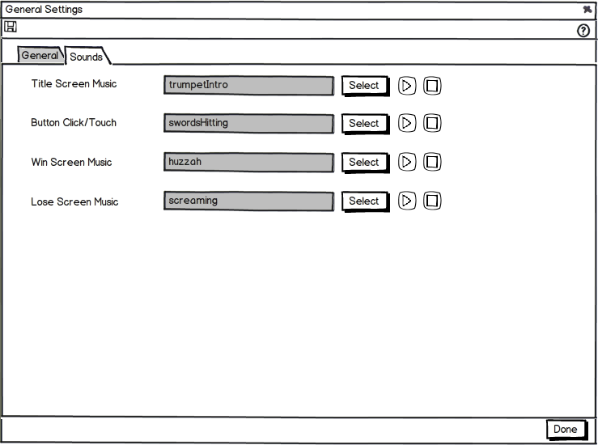
General Settings - 2
740x550

Slide 3
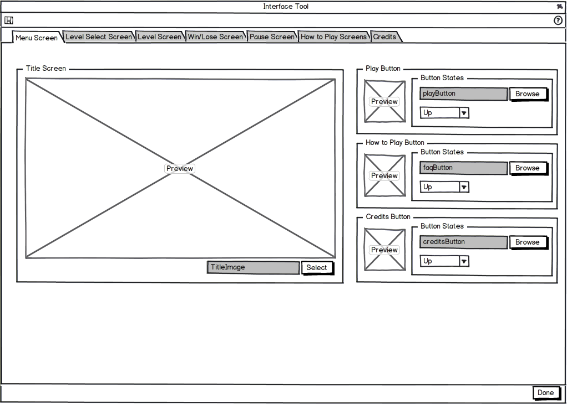
Interface Tool - Menu Screen
950x770
Notes:
Select should be browse

Slide 4
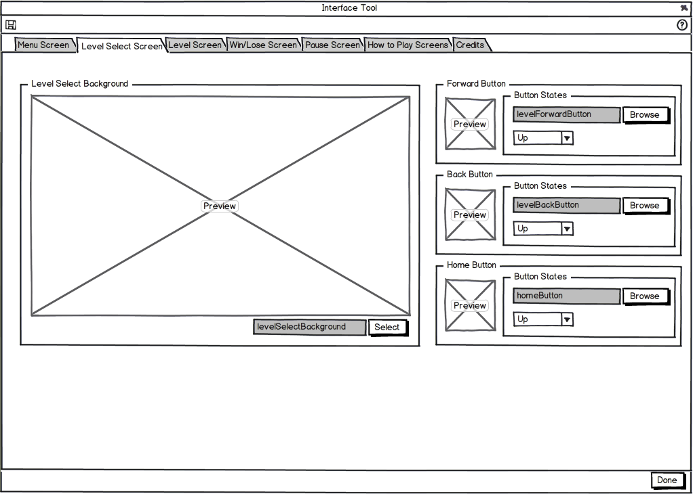
Interface Tool - Level Select Screen
950x770
Notes:
“Select” should be “Browse”

Slide 5

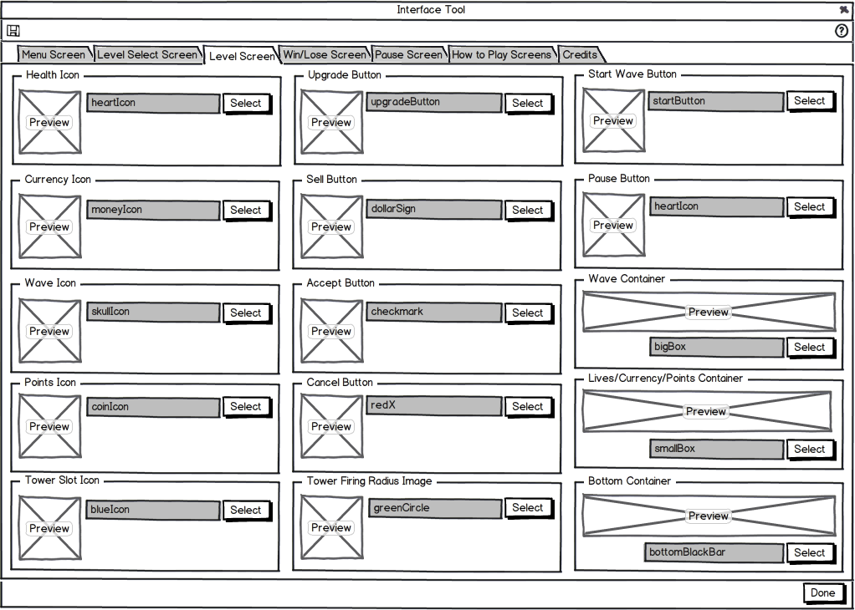
Interface Tool - Level Screen
950x770

Slide 6
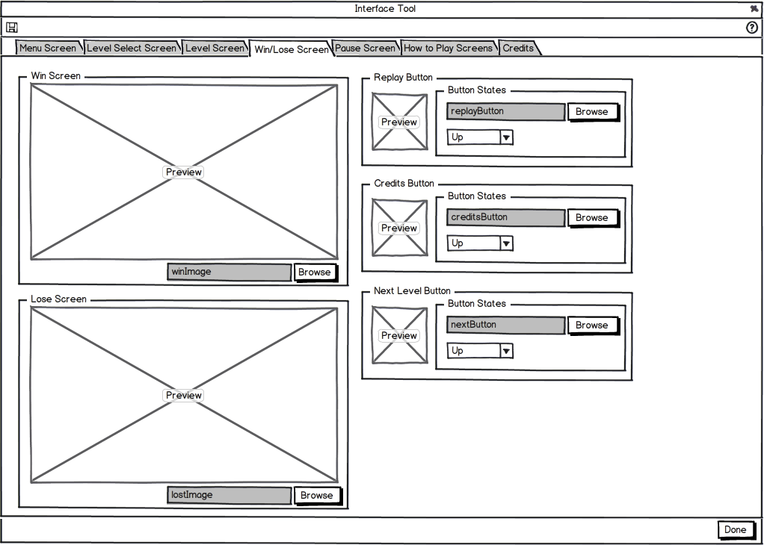
Interface Tool - Win/Lose Screen
950x770

Slide 7
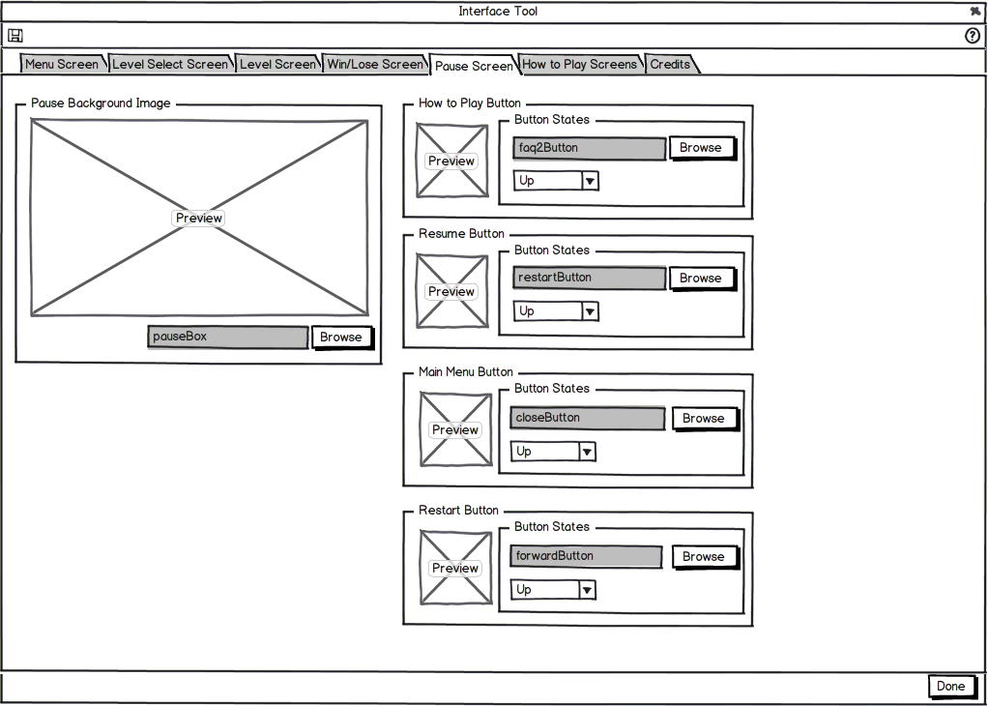
Interface Tool - Pause Screen
950x770
Notes:
“Select” should be “Browse”

Slide 8
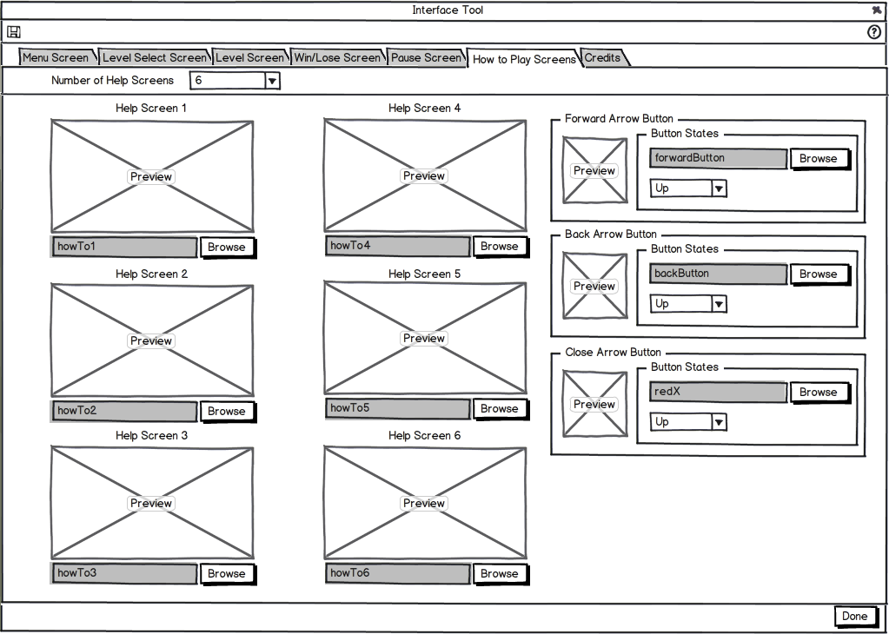
Interface Tool - How to Play Screens
950x770
Notes:
“Select” should be “Browse”

Slide 9
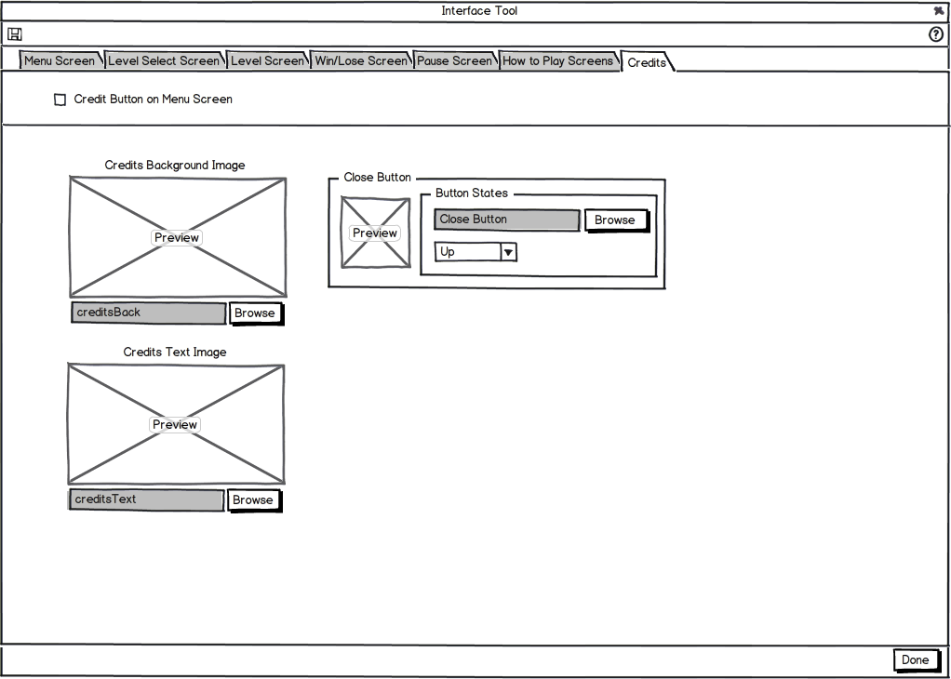
Interface Tool - Credits Screen
950x770
Notes:
“Select” should be “Browse”

Slide 10
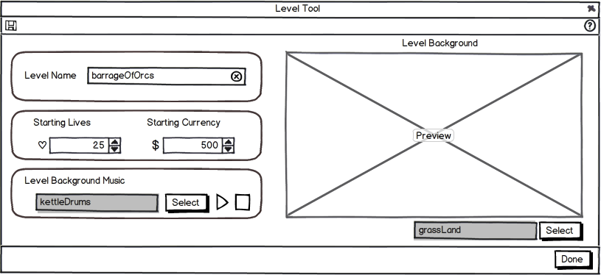
Level Tool
815x375
Notes:
Center “Level Tool” or left justify all others. Make sure Blackjack is consistent as well.

Slide 11
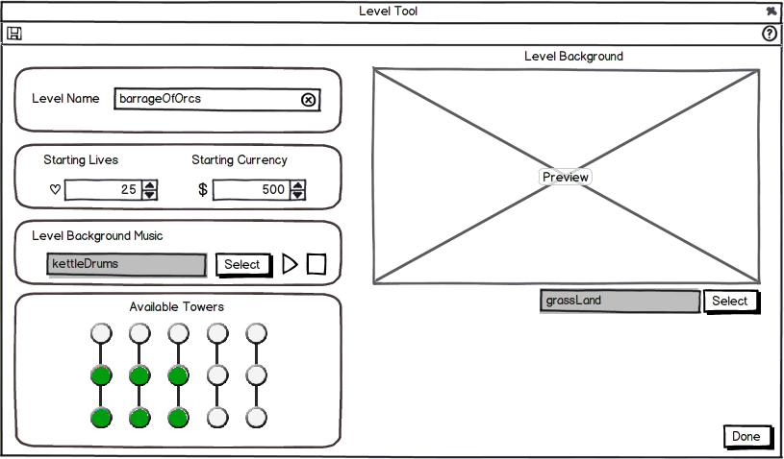
Level Tool – P2 version
Notes:
Added a “Available Towers” option, which ties into the Tower Tree on the Tower Tool, so now you can specify which towers you want available for that specific level

Slide 12
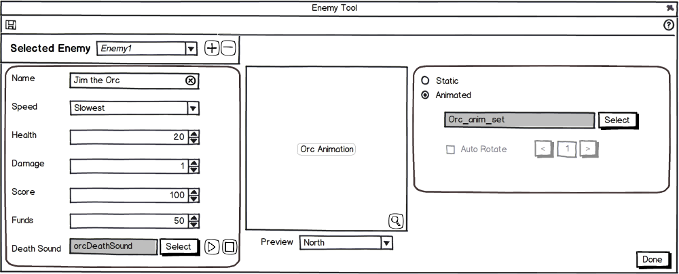
Enemy Tool
1000x400
Notes:
P2 Features: We should add a toggle to preview at zoomed (this is the current) or 100% (what it will look like in game)

Slide 13
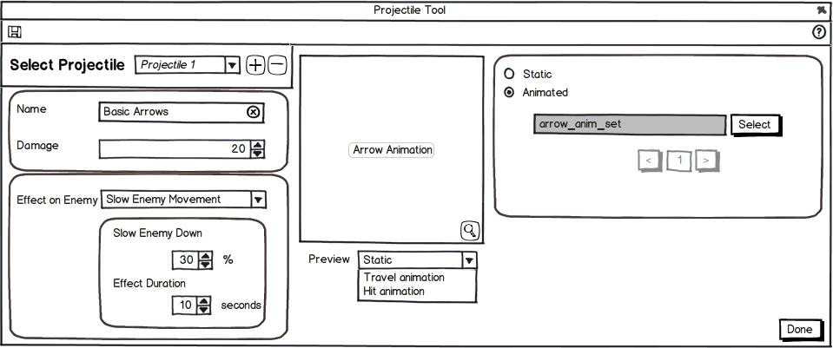
Projectile Tool
960x400
Notes:
Add the other effects and make sure we can maintain this size
P2 Features: We should add a toggle to preview at zoomed (this is the current) or 100% (what it will look like in game)

Slide 14
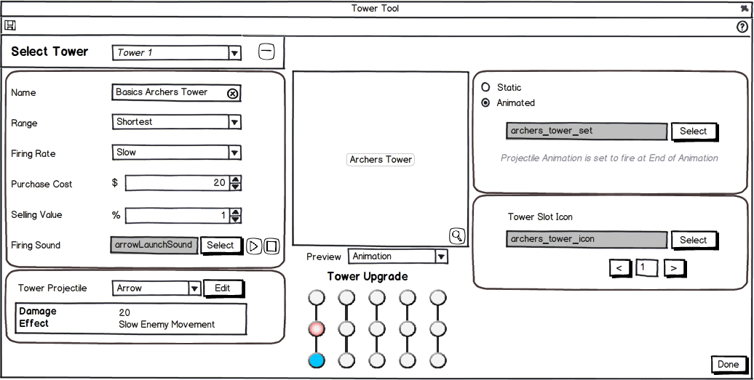
Tower Tool
1000x500
Notes:
P2 Features: We should add a toggle to preview at zoomed (this is the current) or 100% (what it will look like in game)
Erik G mentioned that we should possibly move the “Tower Upgrade” selection widget to the top left instead of having two ways to select towers. I’m not sure what the best approach would be. ---- I think it should stay were it is, it goes back to “Where should the save button be” discussion. If we have it about the preview then the same concept will be right next to each other. Where in usability testing, everyone enjoyed having 2 separated buttons for Save. Also if we move it about the preview, the preview will loose focus

Slide 15
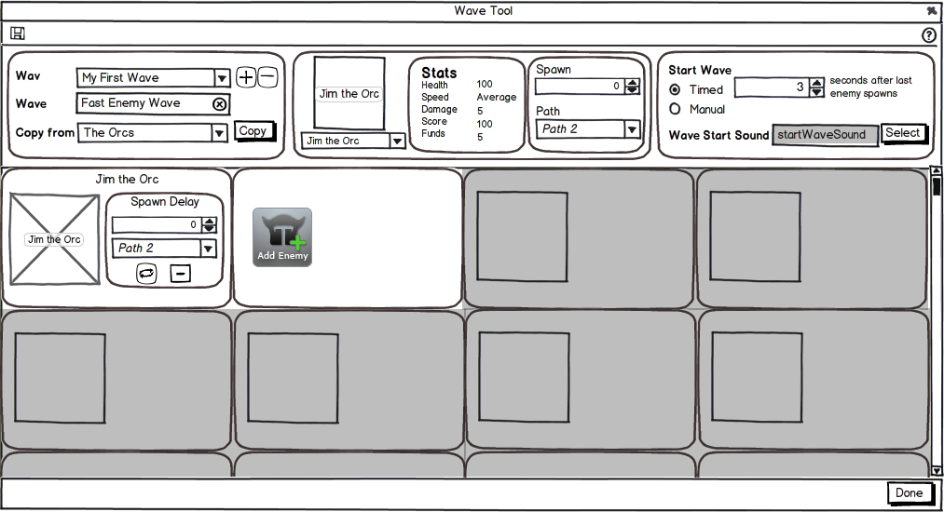
Wave Tool
1015x550

Slide 16
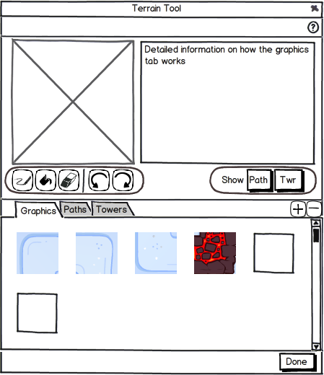
Terrain Tool - Graphics
450x525
Notes:
P2: Look into placing the add/delete functionality into the actual graphics space

Slide 17
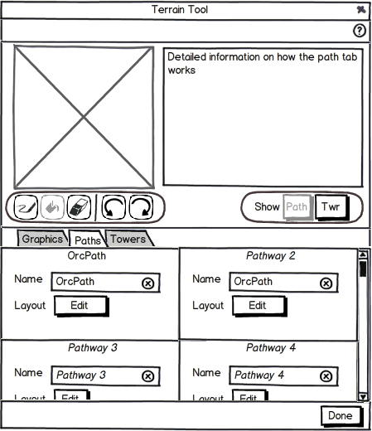
Terrain Editor - Paths 1
450x525

Slide 18
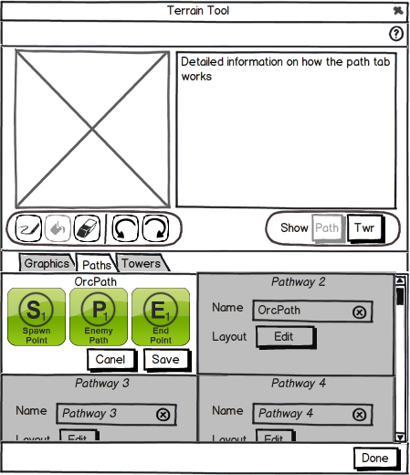
Terrain Editor - Paths 2
450x525

Slide 19
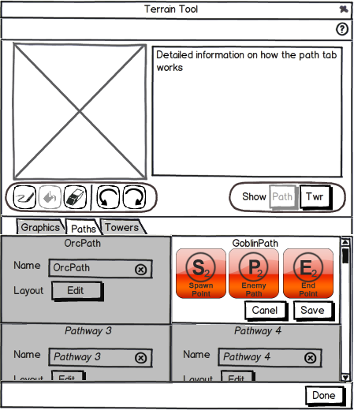
Terrain Editor - Paths 3
450x525

Slide 20
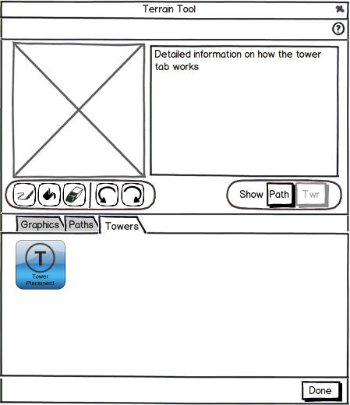
Terrain Editor - Towers
450x525

Slide 21

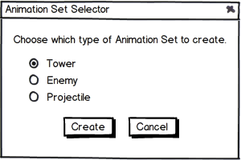
Animation Set Selector
300x200

Slide 22
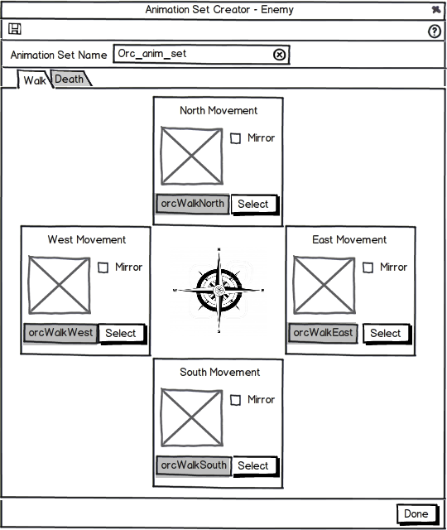
Enemy Animation Set Creator
540x640

Slide 23

Enemy Animation Set Creator
540x640

Slide 24
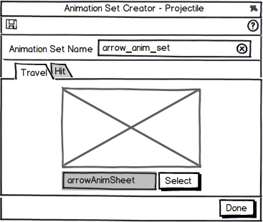
Projectile Animation Set Creator
375x300

Slide 25
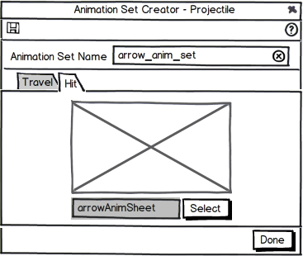
Projectile Animation Set Creator
375x300

Slide 26
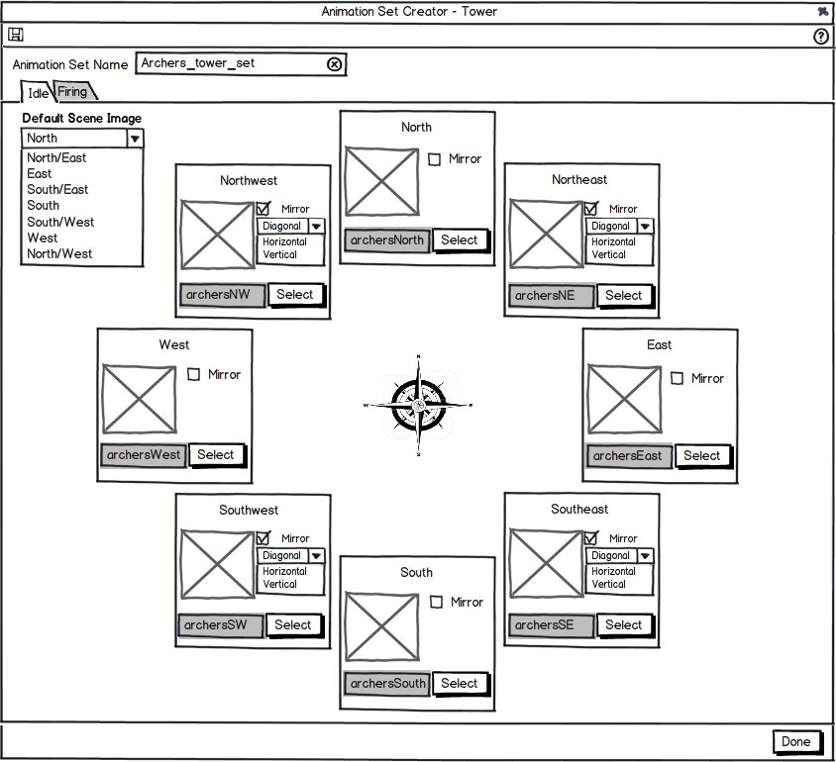
Tower Animation Set Creator
850x775
Notes:
P2: Checkbox to make 1 animation the animation for all

Slide 27
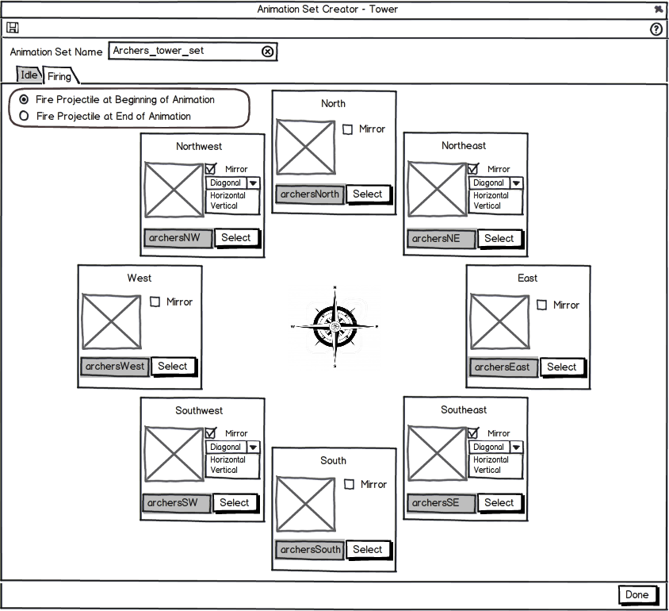
Tower Animation Set Creator
850x775
Notes:
P2: Checkbox to make 1 animation the animation for all

